Slide 1
KV4001 Week 8
Files and File IO

Slide 2
Input and Output Streams
Input is data going into a program.
Output is data flowing out of a program.
IO is frequently done using IO streams.
A stream is a sequence of data flowing from a source to a destination.
IO streams can be connected to a wide variety of data sources and destinations.

Slide 3
IO Streams
The core Java language does not have any IO methods.
For a program to do IO, it must import an IO package:
java.io .*;
Data for a program may come from several sources.
Data created by a program may be sent to several destinations.

Slide 4
IO Sources
An array of bytes
A String object
A file
text
binary
other sources, e.g. an internet connection

Slide 5
The File Class
The File class is used to
obtain file properties
to create files
delete files
rename files.
The File class is intended to deal with most of the machine dependent complexities of files & pathnames in a machine-independent fashion.

Slide 6
Note
Constructing a File instance does not create a file on the machine.
You can create a File instance for any filename regardless of whether it exists or not.
Class API
http://download.oracle.com/javase/8/docs/api/java/io/File.html#File(java.lang.String)

Slide 7
Example
Create a new project Example1 and add the file DirList.java. Look at the method getDirList():
EXERCISE 1: Create a DirList object and execute this method.
import java.io.*;
public class DirList
{
private File path;
private String [] fileNames;
...
public void getDirList()
{
path = new File(“.”);
filenames = path.list();
output();
}
Note the import statement
path – object of type File
an array of type String
“.” means current directory
private helper method

Slide 8
The File Class Constructors
There are several different constructors.
We are interested in the one with a String parameter.
The filename is a string.
Note of file names:
Do not use absolute filenames in your program as they may not be platform independent.
You should use a file name relative to the current directory.
For example, you may create a File object using
new File(“Welcome.java”) for the file Welcome.java in the current directory.

Slide 9
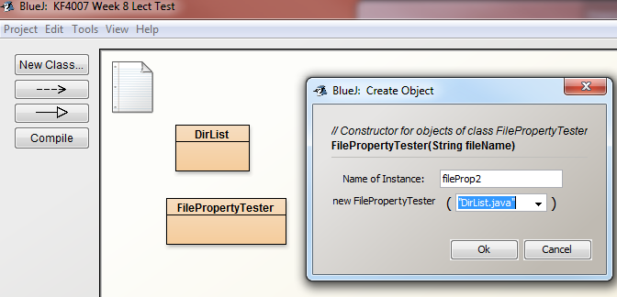
Exercise 2
Add the file FilePropertyTester.java to your project.
This class provides some methods for examining file states.
Use the methods to determine properties of the file DirList.java

Slide 10
Character Streams and Byte Streams
Character streams are intended exclusively for character data.
Character streams are optimised for character data and perform some other useful character oriented tasks.
Byte streams are intended for general purpose input and output.
Fundamentally all data consist of patterns of bits grouped into 8-bit bytes.

Slide 11
Think of types of file that do not contain character data.
Write your answer here

Slide 12
Types of Streams
A stream object may be:
An input stream or an output stream;
A character-oriented stream or a byte-oriented stream;
And may be connected to a variety of sources or destinations
Java uses the same data formats for all computers / operating systems.

Slide 13
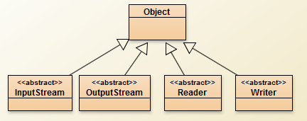
Hierarchy for the java.io Package
byte-oriented
streams
character-oriented streams

Slide 14
Readers and Writers
Readers & Writers deal with character streams.
These are abstract classes.
A program must use classes derived from them.
For example, a BufferedReader is a type (kind) of Reader

Slide 15
General Notes
Character streams are optimised for handling character data.
They also translate between the internal format used by Java programs and an external format used for text files.
Inside a Java program, character data is represented with the 16-bit char data type. The characters of a String use the same 16-bit code.
On a disk file, characters are represented in a format called UTF (Unicode Transformation Format).
This format uses one, two, or three bytes per character and is intended to be a universal format
one format for all text files in any language, anywhere in the world.

Slide 16
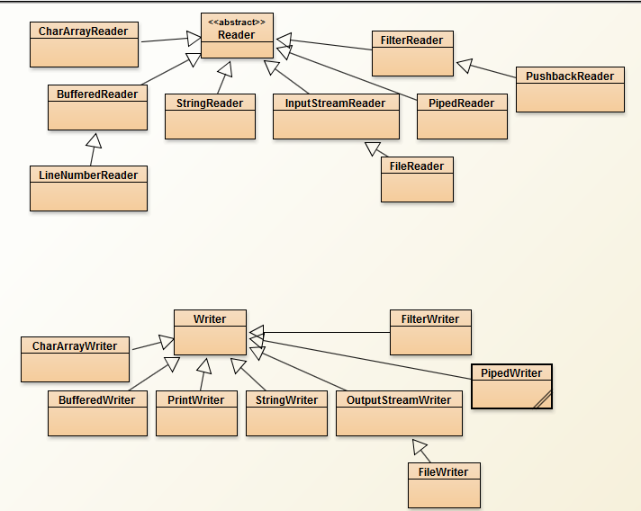
Readers
Writers

Slide 17
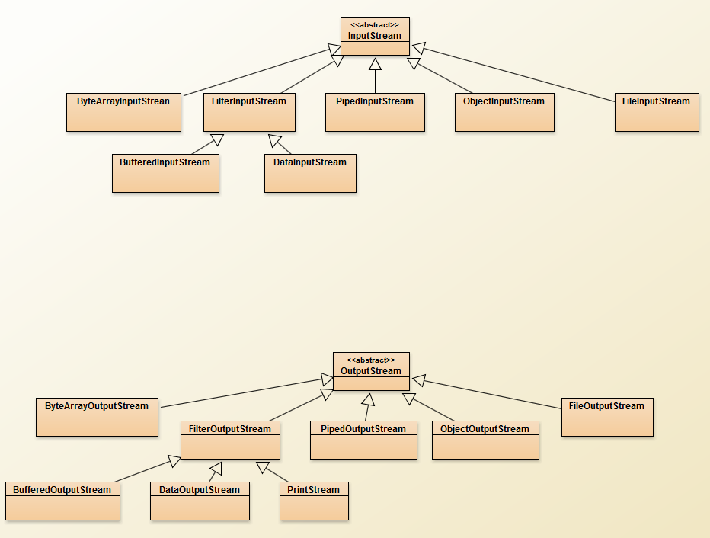
InputStream
InputStream is an abstract class from which all byte-oriented input streams are derived.
OutputStream
OutputStream is an abstract class from which all byte-oriented output streams are derived.
I/O classes

Slide 18
Java File I/O
In order to perform I/O you need to create objects using appropriate Java I/O classes.
These objects contain the methods for reading/writing data from/to a file.
This section introduces how to read/write strings & numeric values from/to text file using the PrintWriter & Scanner classes.

Slide 19
file processing pattern
Link to a file
declare a File object
pass it to a stream object
Process the data
while (not end of data)
process data
Close the file
close()

Slide 20
PrintWriter
The java.io.PrintWriter is a basic class that can be used to write data to a text file.
Two constructors of interest:
PrintWriter(String filename)
PrintWriter(File file)
NOTE: If the file already exists, the existing content of the file will be discarded.

Slide 21
PrintWriter
Both throw FileNotFoundException.
If the given file object does not denote an existing, writable regular file and a new regular file of that name cannot be created.
if some other error occurs while opening or creating the file.
A checked exception so must do something.

Slide 22
Example
public class WriteData
{
private File file;
private PrintWriter output;
public WriteData(String fileName)
{
file = new File(fileName);
if (file.exists())
{
throw new IllegalStateException ( fileName + " already exists");
}
}
More on next slide

Slide 23
public void makeLink() throws FileNotFoundException
{
output = new PrintWriter(file);
}
public void writeToFile()
{
output.print("John T Smith ");
output.println(90);
output.print("Eric K Jones ");
output.println(85);
}
public void closeLink()
{
output.close();
}
} // end WriteData
spaces before 2nd “s
print() & println()
- use as with System.out but writing to a file rather than standard output (the terminal window)

Slide 24
Exercise 3
Add the file WriteData.java
Read the code.
Open Windows Explorer to show the contents of your project folder so you can see what happens as you call the methods.
Run the following four experiments:
Experiment 1
Create a WriteData object with a file name “test1.txt”
Invoke makeLink()
Invoke writeToFile()
Invoke closeLink()
Examine your text file
experiments continued on next slides

Slide 25
Exercise 3 (cont)
Experiment 2
Create a WriteData object with file name “test2.txt”
Invoke makeLink()
Invoke writeToFile()
Remove the WriteData object
Examine your text file
Delete it
Experiment 3
Create a WriteData object (“test3.txt”)
Invoke writeToFile()
What happens?
How would you deal with this?
Experiment 4 on next slide

Slide 26
Exercise 3 (cont)
Experiment 4
Create a WriteData object (“test4.txt”)
Invoke closeLink()
What happens?
How would you deal with this?
try
{
// code
}
catch ( NullPointerException e)
{
System.err.println(" PrintWriter not assigned");
}

Slide 27
Closing a file
The close() method should always be used when a program is done with a file.
If a file is not closed, the program might end before the operating system has finished writing data to the file.
The data written to the file might be lost!
Or it might not! Depends on how busy the operating system is. This is a notorious computer bug.
It can be very frustrating, because sometimes a buggy program will work correctly, and sometimes not.

Slide 28
Reading from a file
Java provides many classes to help read text from a file
see slide for Readers
We will use the Scanner class
See:
http://download.oracle.com/javase/8/docs/api/java/util/Scanner.html

Slide 29
Constructors for Scanner
Many but one we are interested in is:
public Scanner(File source) throws FileNotFoundException
To create a Scanner to read data from a file
create an instance of the File using the constructor
new File(filename)
use new Scanner(File) to create a Scanner for the file.
Invoking the constructor new Scanner(File) may throw a FileNotFoundException.

Slide 30
More Scanner methods
nextInt(), nextDouble(), next(), nextLine(), etc. can be used with reading from a file as well as a keyboard.
These have preconditions: a token of the format specified by method used, otherwise fails.
To verify these preconditions use:
hasNextBoolean()
hasNextInt()
hasNextDouble()
hasNext()
close()

Slide 31
Reading Data Using Scanner
The following example creates an instance of Scanner and reads data from the file created in the WriteData example.

Slide 32
Exercise 4
Add add the file ReadData.java to your project.
Examine the code
a very similar structure to WriteData
Create a ReadData object to read from a file called“scores.txt”
Use WriteData to create the text file and then create a ReadData object to read it.
Carry out the experiments on the next slide ->

Slide 33
ReadData exercises
Experiment 1
create a ReadData object (if not already done).
invoke the following methods
makeLink()
readFromFile()
readFromFile()
closeLink()
Experiment 2
repeat experiment 1 but insert an extra readFromFile()
what happens?

Slide 34
Dealing with end of file
Problem is attempting to read beyond the end of the data in the file
Can use Scanner has ‘has...’ methods to solve problem
e.g.
if ( input.hasNext() )
read data
else
do not read data
while ( input.hasNext() )
{
// read from file
// process data
}

Slide 35
Final Exercise - 1
Write a class ‘CreateEnrolled' which should create a text file 'enrolled.txt' containing the following:
You may hard code the data but a better way would be to utilise a loop and use a Scanner object that takes input from the keyboard (using System.in) until a sentinel value signalling completion is entered.
Write a class ‘ReplaceText’ that reads enrolled.txt and writes the data to a 2nd text file 'graduated.txt', but replaces all occurrences of the string “enrolled” with “graduated” in the new file. (See next slide)
NOTE: the String class has a method to replace all occurances of a string with a new value:
replaceAll(String regex, String replacement)
e.g. String outStr = inStr.replaceAll("enrolled", "graduated");
Alan Alda 111 enrolled
Barbara Bach 222 enrolled
Charlotte Church 333 deferred
Daniel Defoe 444 enrolled
Emilio Estevez 555 enrolled

Slide 36
Final Exercise - 2
ReplaceText should use modified versions of the ReadData & WriteData classes we have just developed: (Call them ReadData2.java & WriteData2.java).
ReplaceText
Should create instances of the read & write classes, calling their makeLink() methods;
Have a changeText() method to:
read a line from the input file, using the ReadData2 object
while not null; create a new string with any use of 'enrolled' replaced with 'graduated;
write the string to the output file, using the WriteData2 object.
get the next line
Have a method to close the file objects.
ReadData2:
readFromFile() should read a single line of text (but could use hasNext() to return a line of text if it exists or 'null' if not).
WriteData2:
writeToFile(String string) writes the string to 'graduated.txt'.

Slide 37
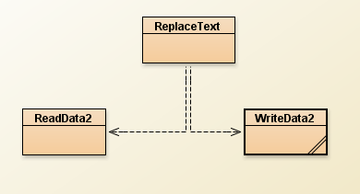
Final Exercise - 3
ReplaceText
ReadData2
WriteData2
Once you have finished consider how you
have handled any possible exceptions.

Slide 38
Review
We have only touched on the Java stream IO framework
Many more classes provided which give extra functionality
Exercise in own time:
research Java Stream IO

